Slide 1
AI IN SPACE EXPLORATION

Slide 2
ROLE OF AI IN SPACE EXPLORATION
SATELLITE IMAGE PROCEESING & ANALYSIS
PLANET INDETIFICATION USING AI
DETERMINING GEOEFFECTIVINES OF SOLAR STORM
AUTONOMUS NAVIGATION for ROVERS

Slide 3
Satellite image processing & Analysis
Satellite Image Processing consists of the images of earth and satellites taken by the means of artificial satellites.
Firstly, the photographs are taken in digital form and later are processed by the computers to extract the information.
Statistical methods are applied to the digital images and after processing the various discrete surfaces are identified by analyzing the pixel values.

Slide 4
Features
Providing a base map for reference
Terrain prediction
Applications in Agriculture and Forestry
Monitoring Climate Change

Slide 5
What is an Image processing?
Image processing is a method to perform operations on a raw image, in order to get an enhanced image or to extract some useful information from it.
It is a type of signal processing in which input is an image and output may be image with characteristics/features.
Digital image processing & analog Image processing

Slide 6
Implementation
Objective:- land classification using sentinel satellite data
Sentinel Satellite are specifical designed to provide high Resolution Images
Algorithm :-CART( classification and regression tree)
API- google Earth engine (global data set)
Code editor- Google Earth code editor
Language – scripting language (JavaScript)

Slide 7
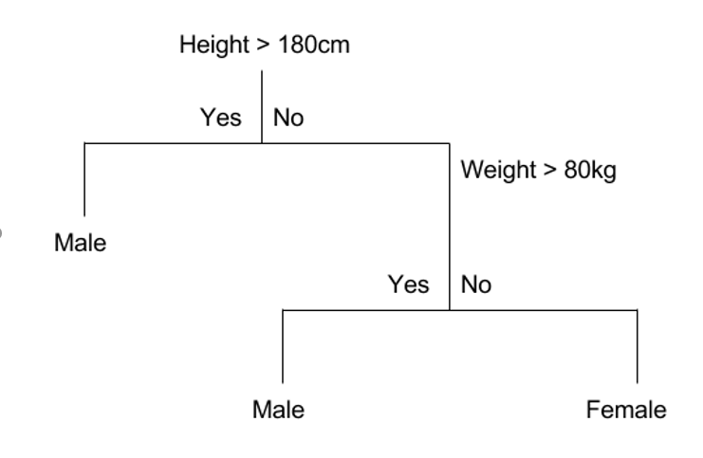
CART(algoritm)
CART- Classification and regression Tree
There exit two types of trees Classification and regression tree
A classification tree is an algorithm where the target variable is fixed or categorical. The algorithm is then used to identify the “class” within which a target variable would most likely fall.
An example of a classification-type problem would be determining who will or will not subscribe to a digital platform; or who will or will not graduate from high school.
Classification trees are used when the dataset needs to be split into classes that belong to the response variable. In many cases, the classes Yes or No.

Slide 8
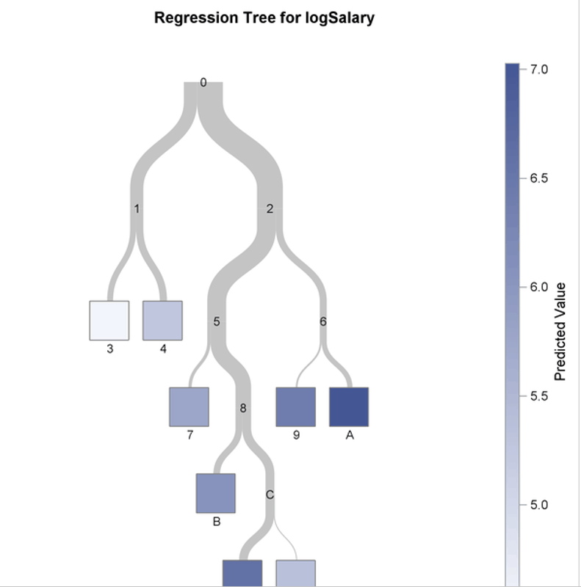
Regression Tree
A regression tree refers to an algorithm where the target variable is and the algorithm is used to predict its value. As an example of a regression type problem, you may want to predict the selling prices of a residential house, which is a continuous dependent variable.
This will depend on both continuous factors like square footage as well as categorical factors like the style of home, area in which the property is located, and so on.
Regression trees, on the other hand, are used when the response variable is continuous. For instance, if the response variable is something like the price of a property or the temperature of the day, a regression tree is used.
In other words, regression trees are used for prediction-type problems while classification trees are used for classification-type problems.

Slide 9
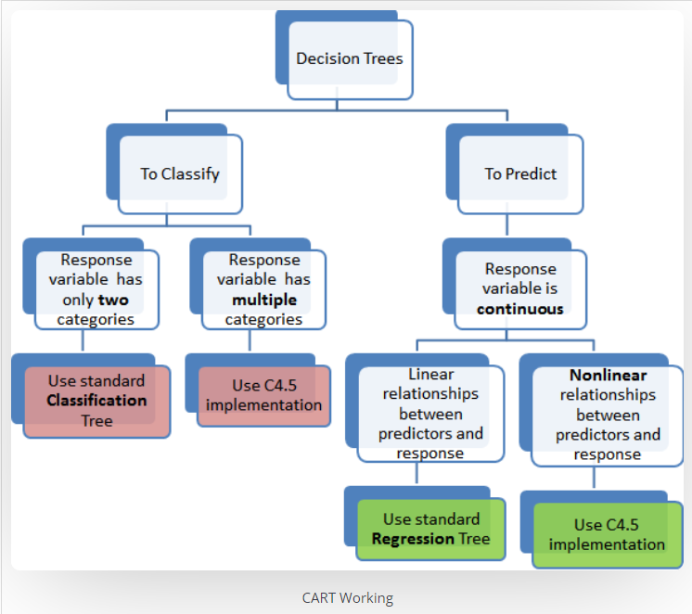

Slide 10
Advantages of CART
The Results are Simplistic
Classification and Regression Trees are Nonparametric & Nonlinear
Classification and Regression Trees Implicitly Perform Feature Selection

Slide 11
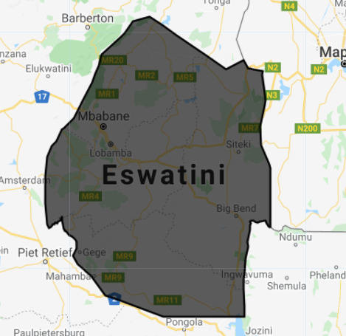
Here we considering a small country in African continent named ‘ Swaziland’
It is also know as Kingdom of Eswatini
The country resides in the south, neighboring to south Africa

Slide 12

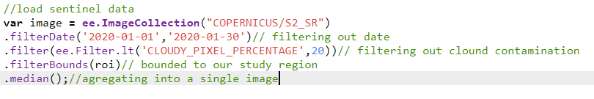
Import country data set
Import Sentinel Data

Slide 13
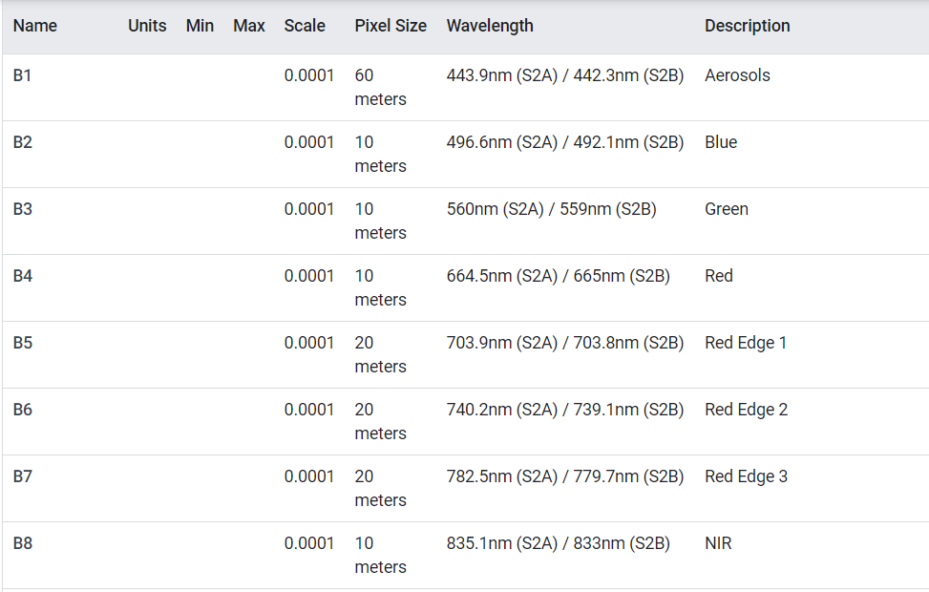
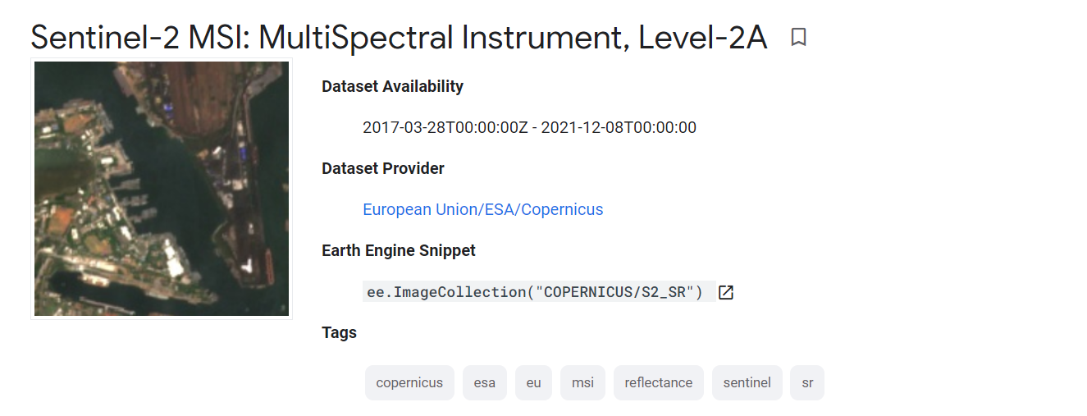
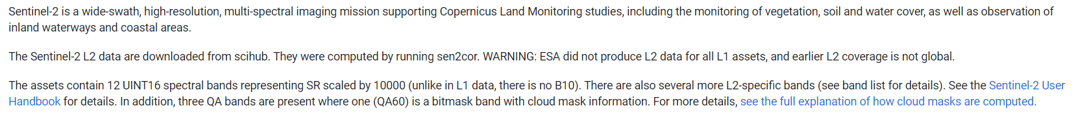
Sentinel data

Slide 14

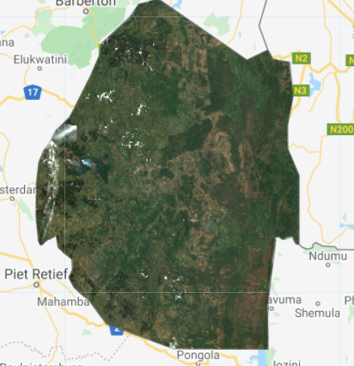
We are using sentinel bands of B4 B3 B2 which are using 10m resolutions

Slide 15
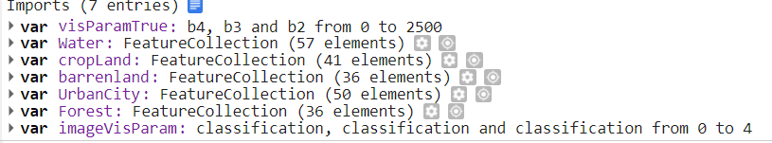
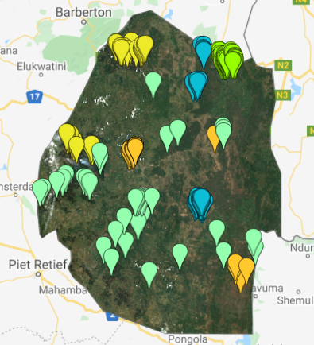
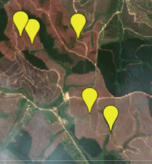
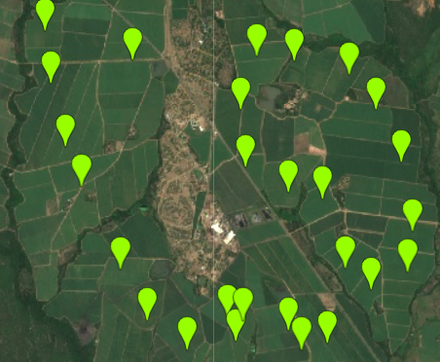
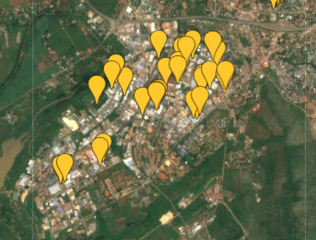
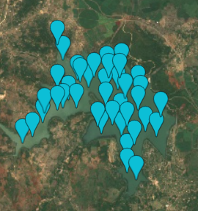
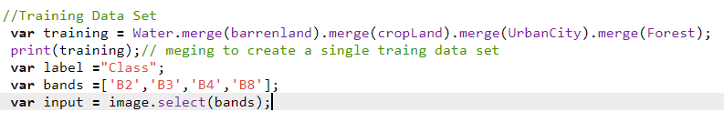
Training data creation

Slide 16
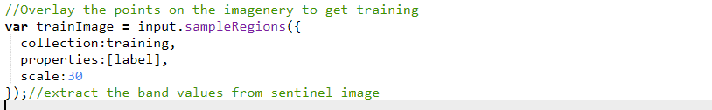
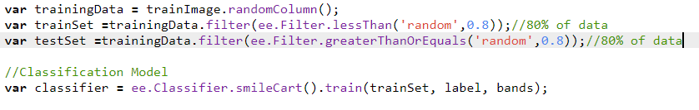
Training the model
Extract the band values from the data point that we have set from the sentinel image
Train the model using smilecart () and train function()
Trains the classifier on a collection of features, using the specified numeric properties of each feature as training data.

Slide 17
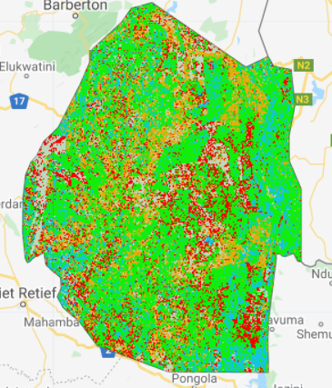
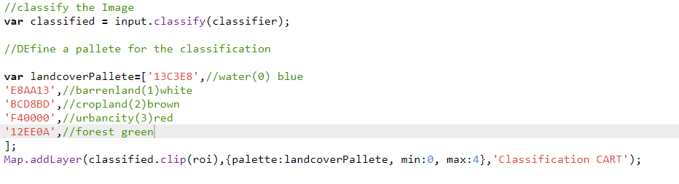
Results

Slide 18
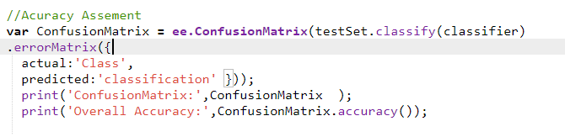
Accuracy
Creates a confusion matrix. Axis 0 (the rows) of the matrix correspond to the actual values, and Axis 1 (the columns) to the predicted values.
Computes the overall accuracy of a confusion matrix defined as correct / total.

Slide 19
Thankyou
Name-Omkar Shelke
BITSID-2021H1120009U

